Slide 1
NIEM on the Ground
The Iowa Integrated Justice Initiative

Slide 2
Iowa Integrated Justice (IIJ)
Since 2007, IIJ (formerly CJIS, the Criminal Justice Information Systems Program) has served as a ‘system of systems’ that integrates and shares criminal justice information among Iowa’s justice agencies in a seamless, real-time, and secure manner. IIJ makes Iowa’s justice system more efficient and effective by allowing agencies to share or receive critical information immediately and automatically, eliminating outdated methods and unnecessary manual entry.

Slide 3
Current CJIS Exchanges
Notes:
You will note I have used the term “exchange” a few times already. CJIS is comprised of over 25 individual exchanges. Represented here, you can see the involvement from a wide range of agencies and their systems. Each one of these exchanges streamlines a specific workflow process by moving data along from one agency to another. Many of these involve many senders, for example over 200 law enforcement agencies, 60+ prosecutors, all 99 court clerks. Part of the architecture is the routing to get to the appropriate jurisdiction. I’m going to turn it over to Will to take a deeper dive into what one of these exchanges looks like.

Slide 4
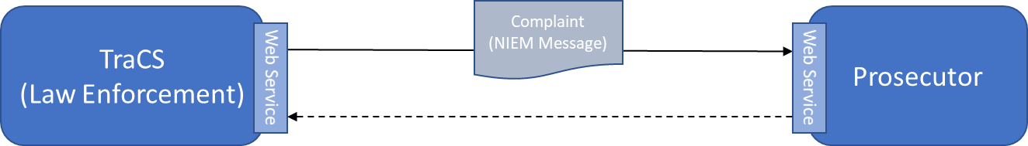
Anatomy of an Exchange
Response
Data validations
Routing
Certificate-based security
Message Delivery verification
Planning – identifying a candidate workflow process
The Service Specification Package – business and architecture requirements
Technical Standards: NIEM, Web-Services, Security
Data management – validations ensure the integrity and accuracy of the data
The importance of response messaging
Notes:
NIEM is the data model, we pull a subset of that data model for each exchange
Cert. based security ensures uninterrupted encryption between agencies
Validations

Slide 5
Overall IIJ Architecture
Enterprise Service Bus
Web Service
Corrections
Law Enforcement
Complaint
NIEM
Complaint
Message Switch/ CCH
Web Service
Courts
Disposition
Disposition
Human Services
Child Support Enforcement
Proxy Web Service
Data validations
Routing
Certificate-based security
Message Delivery verification
Web Service
Web Service
Drivers’ Licensing (DMV)
Prosecutor
Web Service
Web Service

Slide 6
IIJ Governance
Advisory Committee
Advisory Committee
Codes Team
CJIS Coordinator
MCP
CJIS Board
IIJ Board
Governor
Chief Justice
Director of State Courts
Director of Management Services
Judicial:
Judge
Clerk
Court Administrator
State Courts IT
Law Enforcement:
Chiefs’ Association
Sheriffs’ Association
Prosecutor
Public Defender
Department of Corrections
Department of Public Safety
Iowa Counties, Cities Associations
Legislature –
4 members (each house, each party)
Notes:
But the real secret sauce at IIJ is how it has coalesced the justice community around sharing information. It is a share-first culture. a look at the broad governance model here. This structure does a good job of representing the entire justice community and engaging them in building the project. It is also important that all three branches of government are represented, and both political parties. That has proven valuable in going across the street every year for ongoing funding.

Slide 7
IIJ – A Share-First Culture
Information sharing around Event-driven workflow
Broad participation, supported by an inclusive governance structure
Hosted on neutral turf
Has fostered a culture of collaboration and information-sharing
Importance of Architecture to scalable data integration
“Without NIEM, we would still be arguing about how to title “Last Name!”
Notes:
This isn’t just technology, it is almost 20 years of partnership across the entire justice community, statewide, around information-sharing. The ingredients in the success here include broad governance, an information-sharing Architecture that has proven to be scalable – all with NIEM as the foundation.

Slide 8

For More Information
Tammi Blackstone, JD
Data/Research Team Manager & Iowa Integrated Justice Coordinator
Department of Management
Division of Data, Planning, and Improvement
1007 E. Grand Ave., G13, Des Moines, IA 50319
515.725.2264
tammi.blackstone@dom.iowa.gov
dom.iowa.gov

